Slide 1
ROLES OF A STEWARD
PUBLIC EMPLOYEE DEPARTMENT

Slide 2
What a Steward Should Know/Have
Steward Qualities
Steward Roles/Duties
Steward Tools
How to investigate grievances, etc.
PUBLIC EMPLOYEE DEPARTMENT
Notes:
Review areas that will be covered during the presentation

Slide 3
Qualities of a Good Steward
Good communicator – oral and/or written
Good listener
Approachable/make members feel comfortable
Honest
Good problem-solver
Responsible
Decisive
Good supporter/promoter of the union
PUBLIC EMPLOYEE DEPARTMENT
Notes:
Click on slide and ask students what are the Qualities of a Good Steward and list on a flipchart.
Click a second time to compare list on flipchart with the slide.

Slide 4
Qualities of a Bad Steward
Represent unfairly or unequally
Make backroom deals with management
Promise remedies too quickly
Fail to speak with new workers
Fail to adhere to time limits
Fail to file grievances (or ULPs, etc) that have merit
Meet with management alone
Fail to get settlements in writing
Fail to publicize victories
Fail to organize
PUBLIC EMPLOYEE DEPARTMENT
Notes:
Click on slide and ask students what are the Qualities of a Bad Steward and list on a flipchart.
Click a second time to compare list on flipchart with the slide.

Slide 5
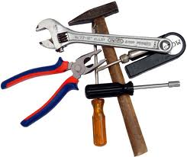
Tools of the Trade
Collective bargaining agreement
Current list of members
Union contacts
File system
Current literature
What else?
PUBLIC EMPLOYEE DEPARTMENT
Notes:
Have students tell the class what a steward should keep on hand and why
Capture on flip chart
Compare to this list on flip chart to slide and discuss relevance of each of these
Additional Tools of the Trade
- Seniority list
- List of Supervisors by Department
- Employer policy and procedures manual
- Grievance forms
- Membership forms
- Other Stewards and their contact information
- Extra copies of contracts for new members
- New member packets
- Notebook/Ink Pens
See/refer to Steward Manual for more suggestions

Slide 6
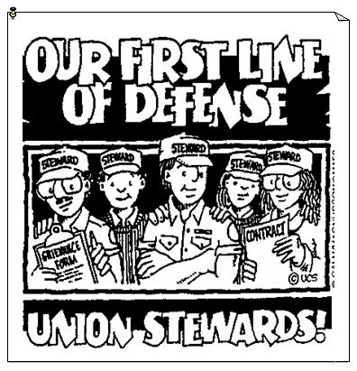
Roles of the Steward
New Employee Point of Contact
Contract Administration
Member Communications
Union Communications
Internal organizing
PUBLIC EMPLOYEE DEPARTMENT
Notes:
Exercise: Break class into 5 groups
Assign each group one of the five categories (Note: clarify what each category means)
New Employee Point of Contact (i.e. member orientation)
Contract Administration (i.e. knowing the contract and checking it)
Member Communications (i.e. communicating with members on issues from local union financial status, politics, and status of bargaining and/or grievances)
Union Communications (i.e. communicating with local union officers/agents and keeping them informed)
Internal Organizing (i.e. signing new members, getting uninvolved members to be active)
Ask students to discuss and then report examples of what a steward might do in carrying out that activity on a flipchart.
Have each group rotate so each team adds roles to reach flipchart.
After each report, review the appropriate slide to corroborate or add to their list.

Slide 7
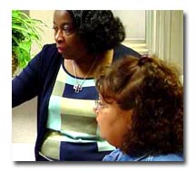
New Employee Point of Contact
Value of first impressions
To them YOU are the union
Less is more
Save the details for later
If not you than who?
PUBLIC EMPLOYEE DEPARTMENT
Notes:
Steward’s responsibility to welcome every new employee into the union – if possible try to do this on the workers first day on the job.
Emphasize how important it is to get workers interested in and familiar with the union.
The steward can conceivably be the first friendly face/helpful person in the workplace.
Union orientation
Get to know one another
Give the worker a copy of the contract
Help new workers see union membership as a natural part of their job, and if your contract doesn’t require them to become members, ask them to join
Explain the dues and what they provide
Discuss what the first day on the job was like for the participants of the class
Use steward manual for more detail

Slide 8
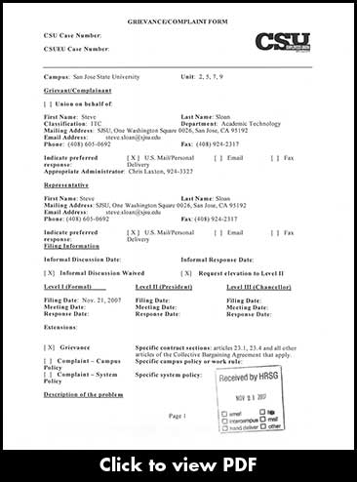
Contract Administration
Be familiar with your contract
Know your grievance procedure
Duty of Fair Representation
All bargaining unit members treated equally
The steward is the union ADVOCATE
not an impartial arbitrator
PUBLIC EMPLOYEE DEPARTMENT
Notes:
The contract is the essence of union representation
Steward should know the contract better than anyone
Stress importance of knowing the contract and checking it
DFR: very important union doesn’t play favorites
Union is obligated to consider each person’s complaint and handle each one using the same standards
Emphasize that union is an advocate not a mediator
You may agree with the employer but you are representing the interests of the workers.
Refer to steward manual for more detail as necessary.

Slide 9
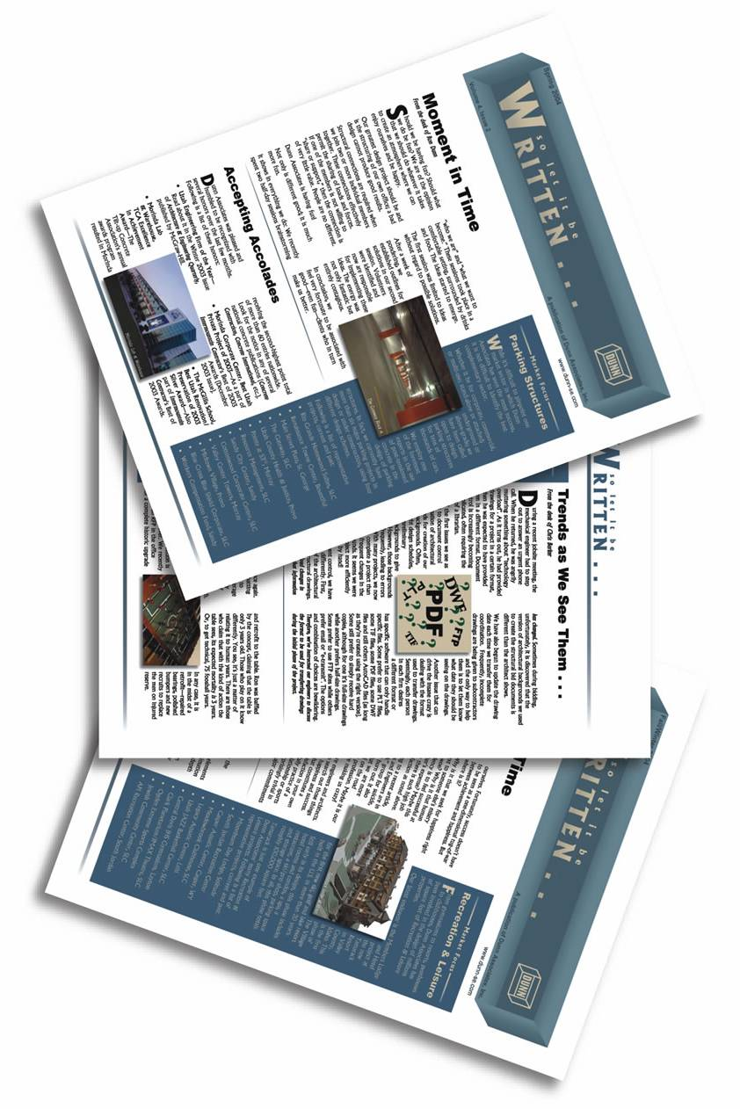
Member Communications
Union meetings: when, where, etc.
Union position on matters
Politics: why important to them
Volunteer and social activities
Status of bargaining, grievances, etc.
PUBLIC EMPLOYEE DEPARTMENT
Notes:
Discuss importance of the steward maintaining open communication with members
Stewards are the key point of contact between LIUNA members and their union leaders
They are responsible for keeping members informed about LIUNA programs and goals, and educating them on the importance of participation in the union and learning about broader issues that affect them and their communities
Discuss examples of types of member communications
Discuss the importance of electing pro-labor candidates
Volunteering helps strengthen our relationships in the community and can result in valuable alliances when we need help achieving union goals
Frustrating when members don’t know what’s going on; feel they are in the dark about union activities and issues
Do not assume that members do not care

Slide 10
Member Communications
Always find time to talk
Schedule time that works
Always get back to people
Always be honest
“I don’t know” is OK
Respect people’s privacy/dignity
PUBLIC EMPLOYEE DEPARTMENT
Notes:
If time, review some basic key tips on communicating with members
Relate back to list of steward qualities
Emphasize how important it is that stewards always tell the truth (even if the truth is bad news)
Don’t give an answer you don’t have
People won’t come to you with their problems if they think you will blab them around.

Slide 11
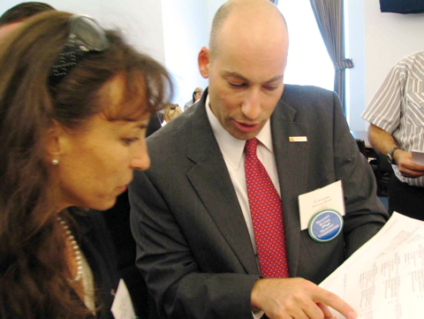
Union Communications
Problems you can’t resolve
Problems you have resolved
Member complaints/ concerns
Opportunities for member involvement or interests
Members in need
Ideas for better meetings
Trouble on the horizon
PUBLIC EMPLOYEE DEPARTMENT
Notes:
The union (local) needs to know what’s going on at your site.
Don’t’ wait for problems to build
Surprises aren’t good
The union officers/agents depend on the steward to fill them in on the members; they know them better than anyone.
Make sure each steward knows who their agent is that services their unit

Slide 12
Union Communications
Always be honest
Admit when/if you make a mistake
Ask for help/support
PUBLIC EMPLOYEE DEPARTMENT
Notes:
Self evident

Slide 13
Internal Organizing
Identify/sign up new members
Help with union paperwork
“Organizing never stops”
PUBLIC EMPLOYEE DEPARTMENT
Notes:
One of the principle activities that stewards do is ORGANIZE
Building the union’s strength internally is a key task of stewards
Organizing is ongoing even at units already “unionized”
Some workers are card carriers, others are members
New members need to be signed up
Help them understand the importance of joining the union
Existing members need to keep their interest in the union alive
Discuss how that happens
Stewards who do a good job with greeting, servicing and communicating will also contribute to internal organizing.
Discuss ramifications of letting an organized unit wither.

Slide 14
Special Steward Rights
Equality Rule
No Reprisal Rule
Equal Standard Rule
PUBLIC EMPLOYEE DEPARTMENT
Notes:
Briefly review the special rights stewards have as agents of the union
Equality Rule – Stewards have he legal right to be treated as an equal to management. Under the National Labor Relations Act, Stewards cannot be punished or discriminated against because of their union activity.
- Example: Can raise your voice when talking with management, threaten legal action, refuse to do what a supervisor tells them to as a Steward
- Limitations: Physically assault management, threaten violence or physical harm, name calling, use of extreme, unprovoked profanity
No Reprisal Rule – Denied promotions or transfer opportunities, denied overtime, assigned less desirable work, supervised more closely, harassed, intimidated, disciplined or threatened with discipline
Equal Standards Rule – Steward’s cannot be held in a higher standard (or allowed a lower standard) of work performance.
Use/discuss handout
If time allows, do scenario based exercise

Slide 15
Recording Keeping
Your notes may be the difference between:
Winning or losing a grievance
Defending or dropping a loser
Getting a better contract
Defending yourself from charges
PUBLIC EMPLOYEE DEPARTMENT
Notes:
Emphasize importance of keeping good notes
Discuss situations when good note taking is helpful, bad note taking is disastrous.
Can’t rely on your memory
Also valuable to write things down for someone else to understand years later
Showcase different types of notebooks, day-timers
Discuss other items listed in the steward manual

Slide 16
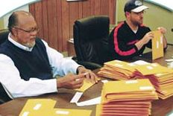
Stewards: Lead by Example
Go to Union meetings
Participate in Union functions
Follow the workplace rules
Be “straight up”
Register to vote and VOTE
Support other unions’ causes
PUBLIC EMPLOYEE DEPARTMENT
Notes:
Self explanatory

Slide 17
Steward 10 Commandments Steward Manual p 4
Love the union
Know yourself
Be a credible employee
Talk straight to the members
Assess your opposition
Tackle small problems before they get big
Anticipate surprises
Set limits
Involve others
Your worksite is one part of a whole
PUBLIC EMPLOYEE DEPARTMENT
Notes:
Conclusion
Self explanatory

